Slide 1

Project Members:
Matt Lewis (ML789)
Suraj Shrestha(Suraj567255)
Raelyn Sangil (RPSangil)
Thomas Gosper (Gosper23)

Slide 2
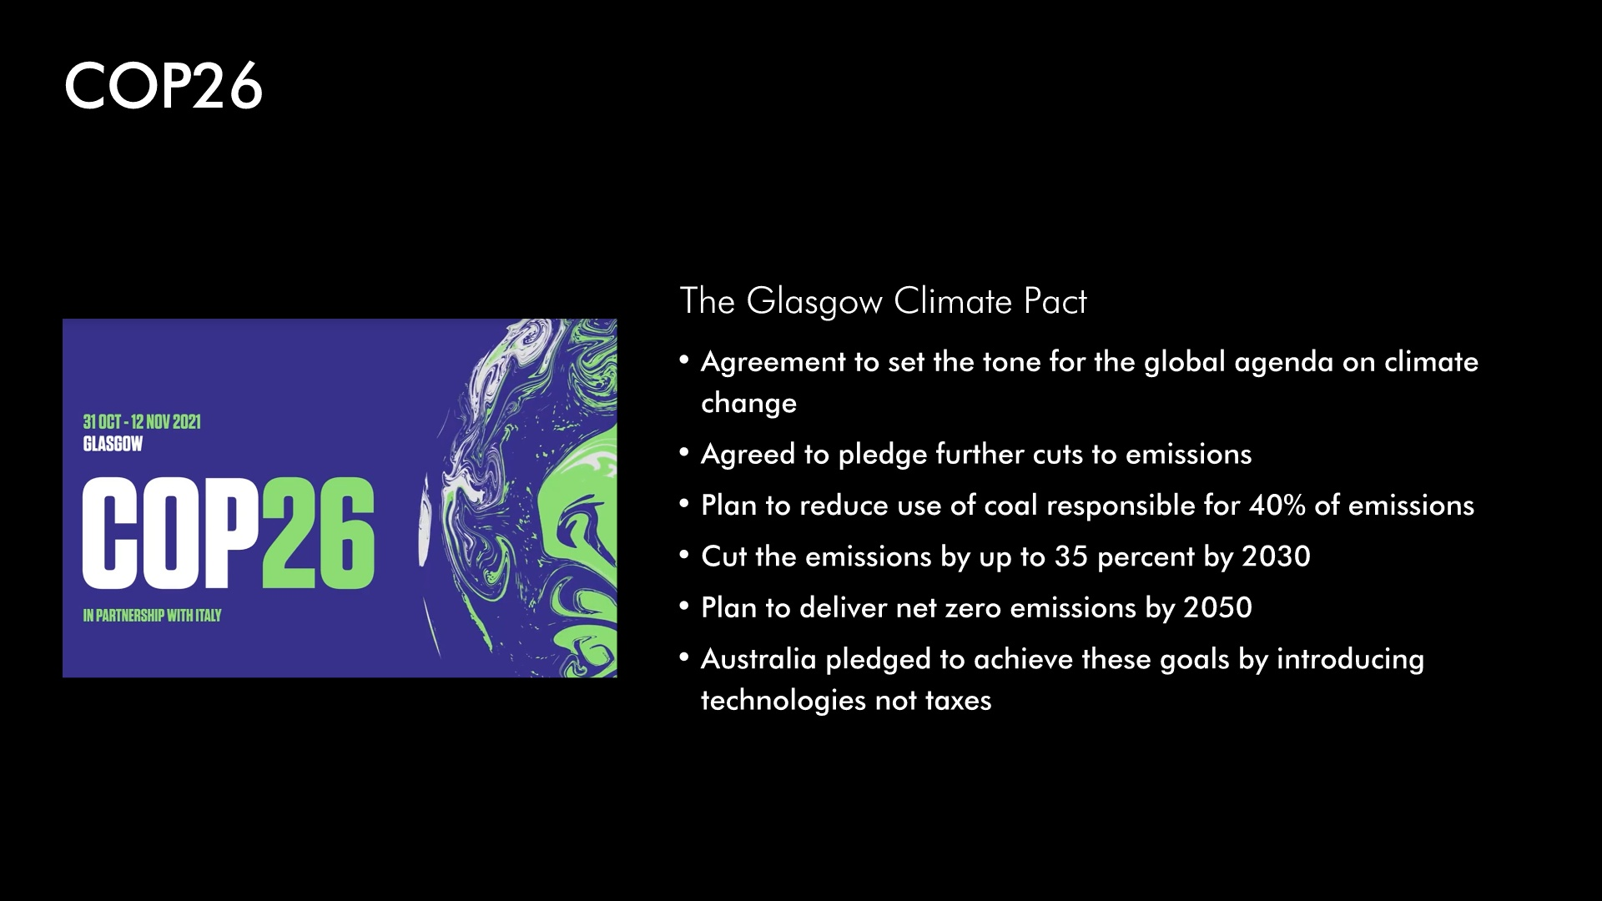

Slide 3
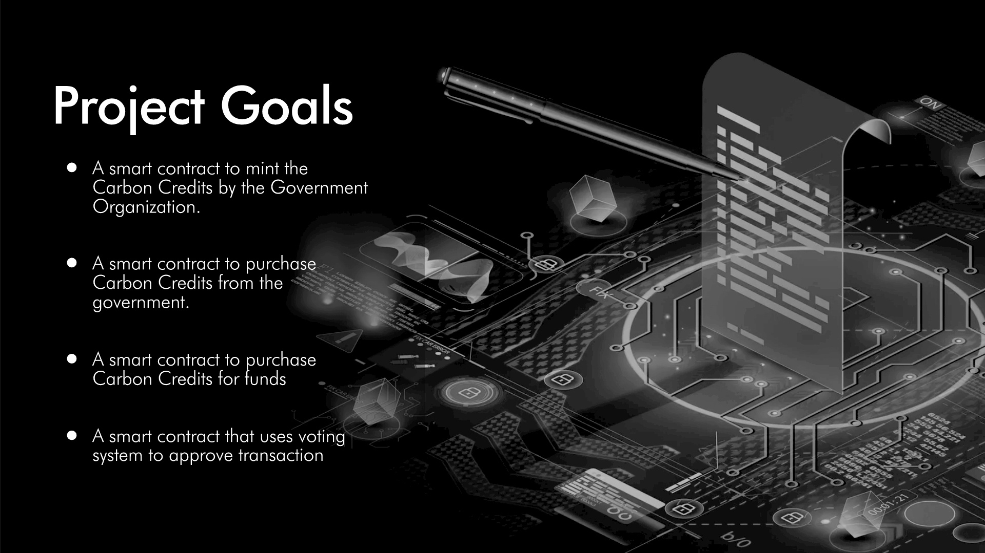

Slide 4
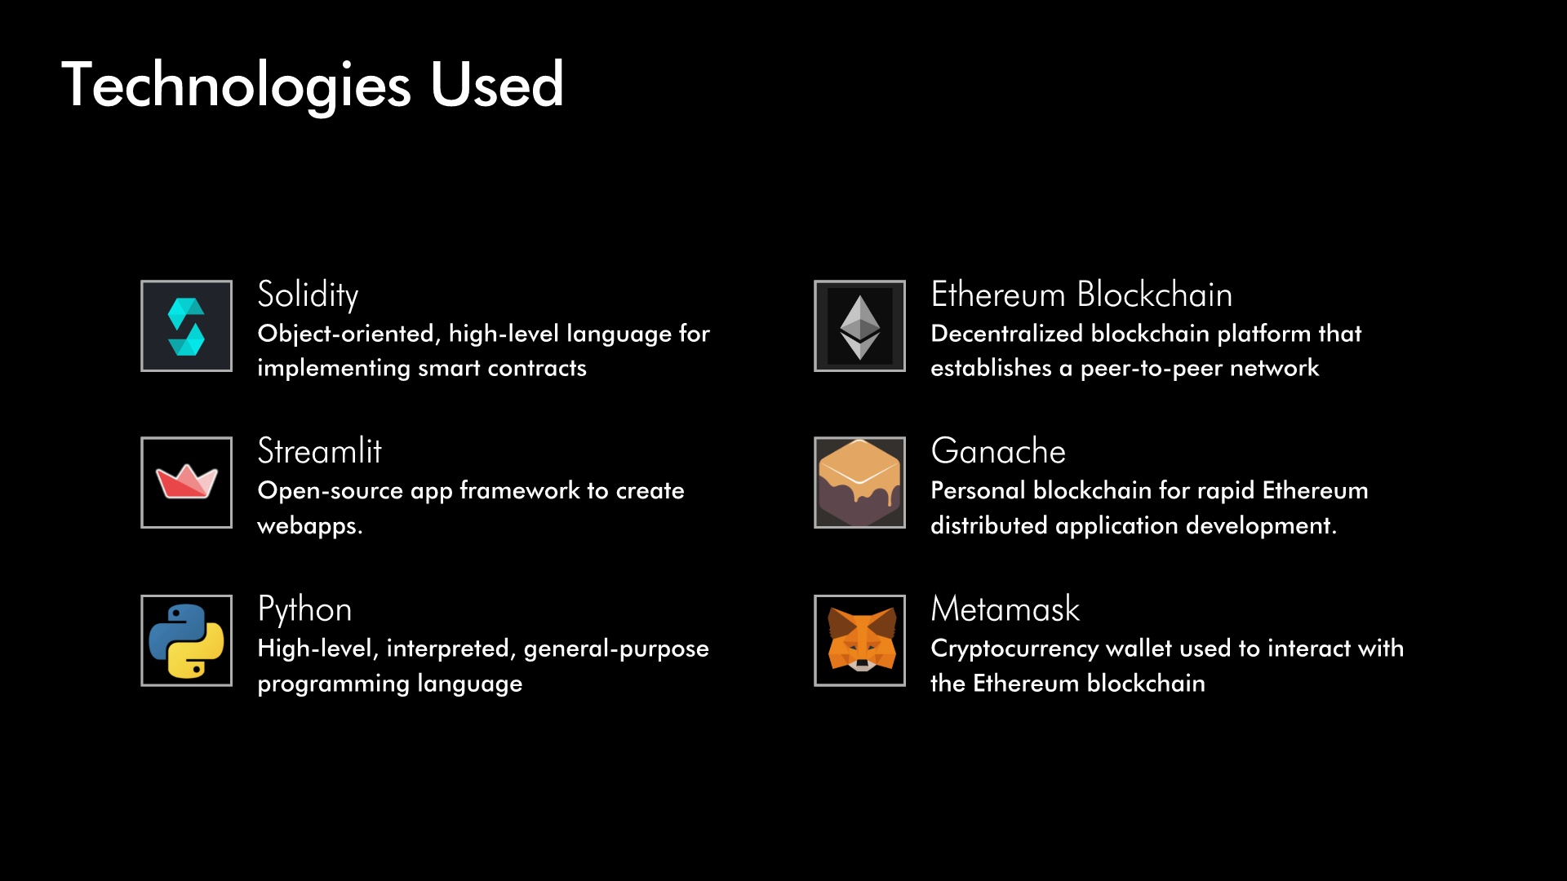

Slide 5
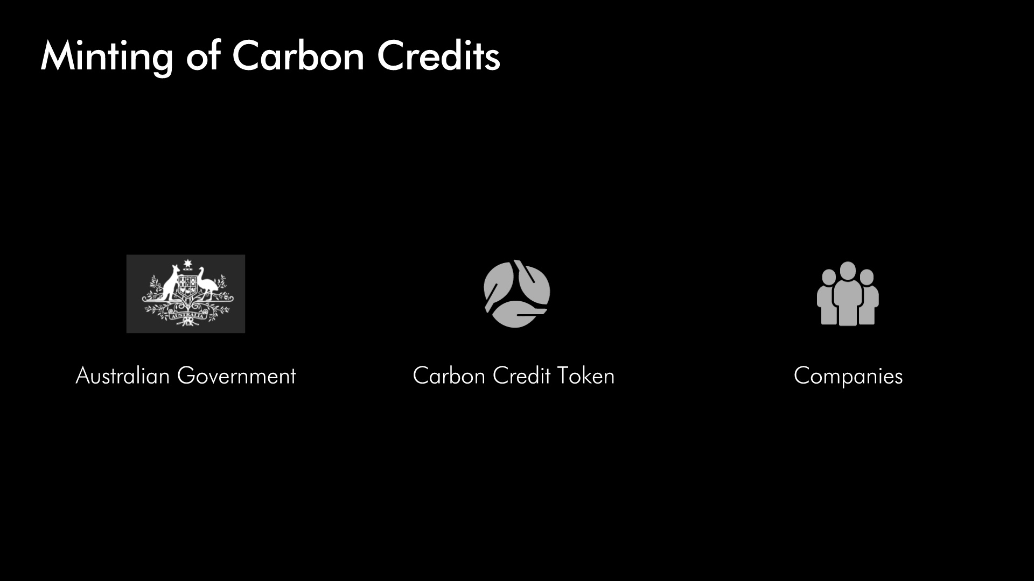

Slide 6
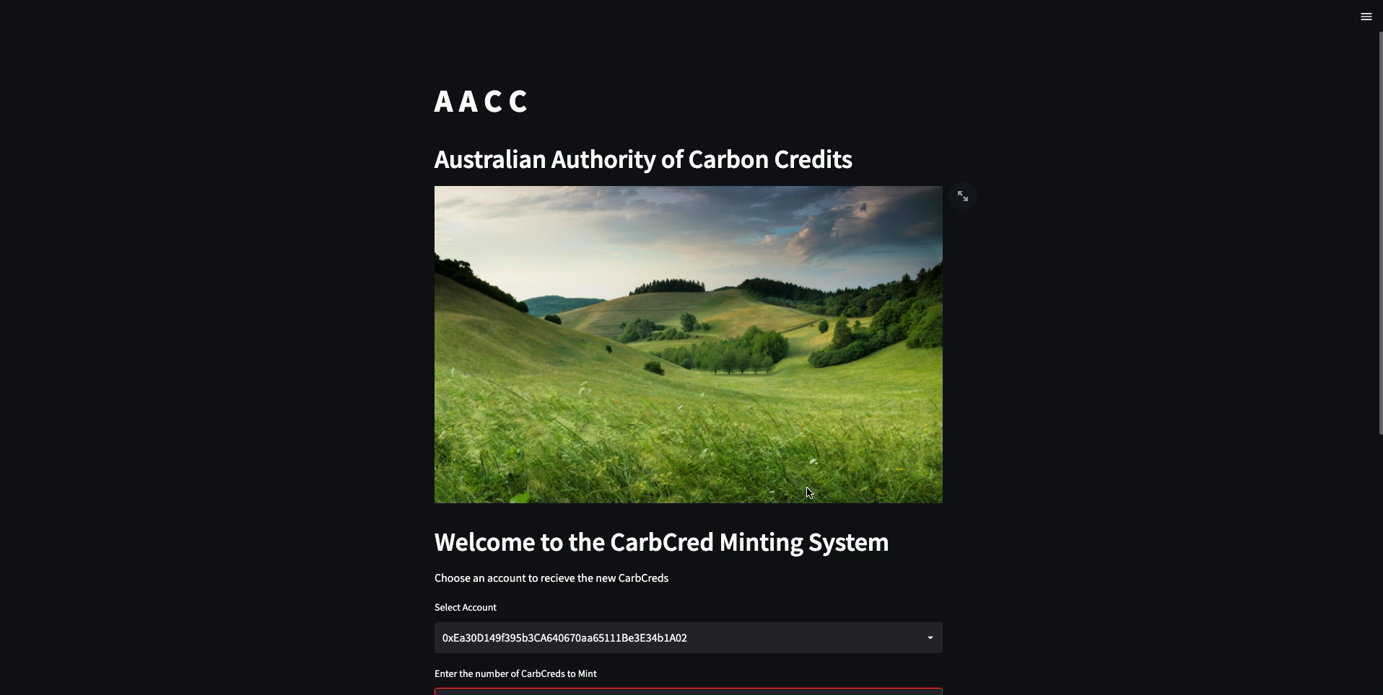

Slide 7

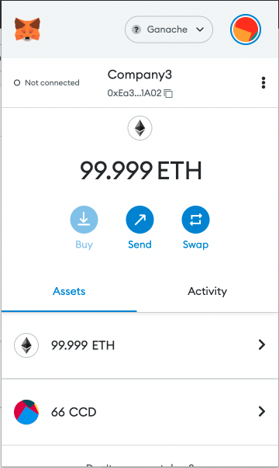
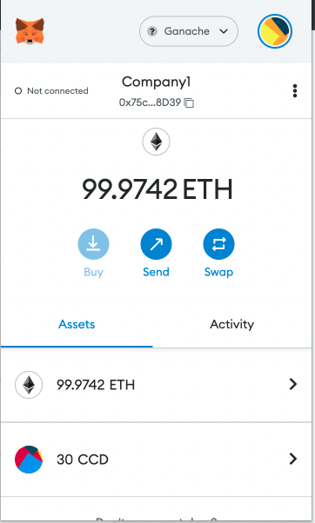
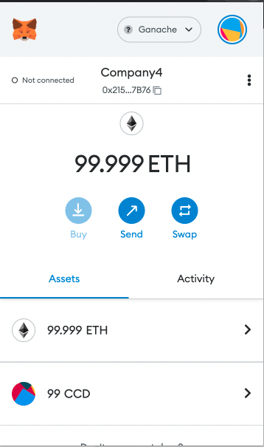
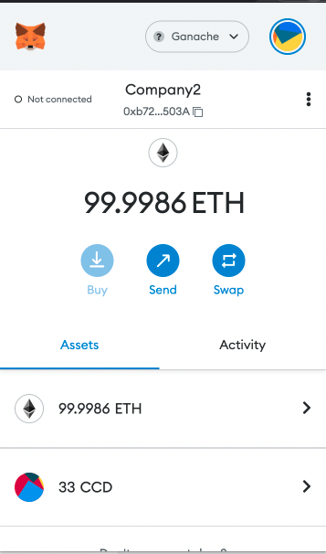
Metamask Screenshots

Slide 8


Slide 9
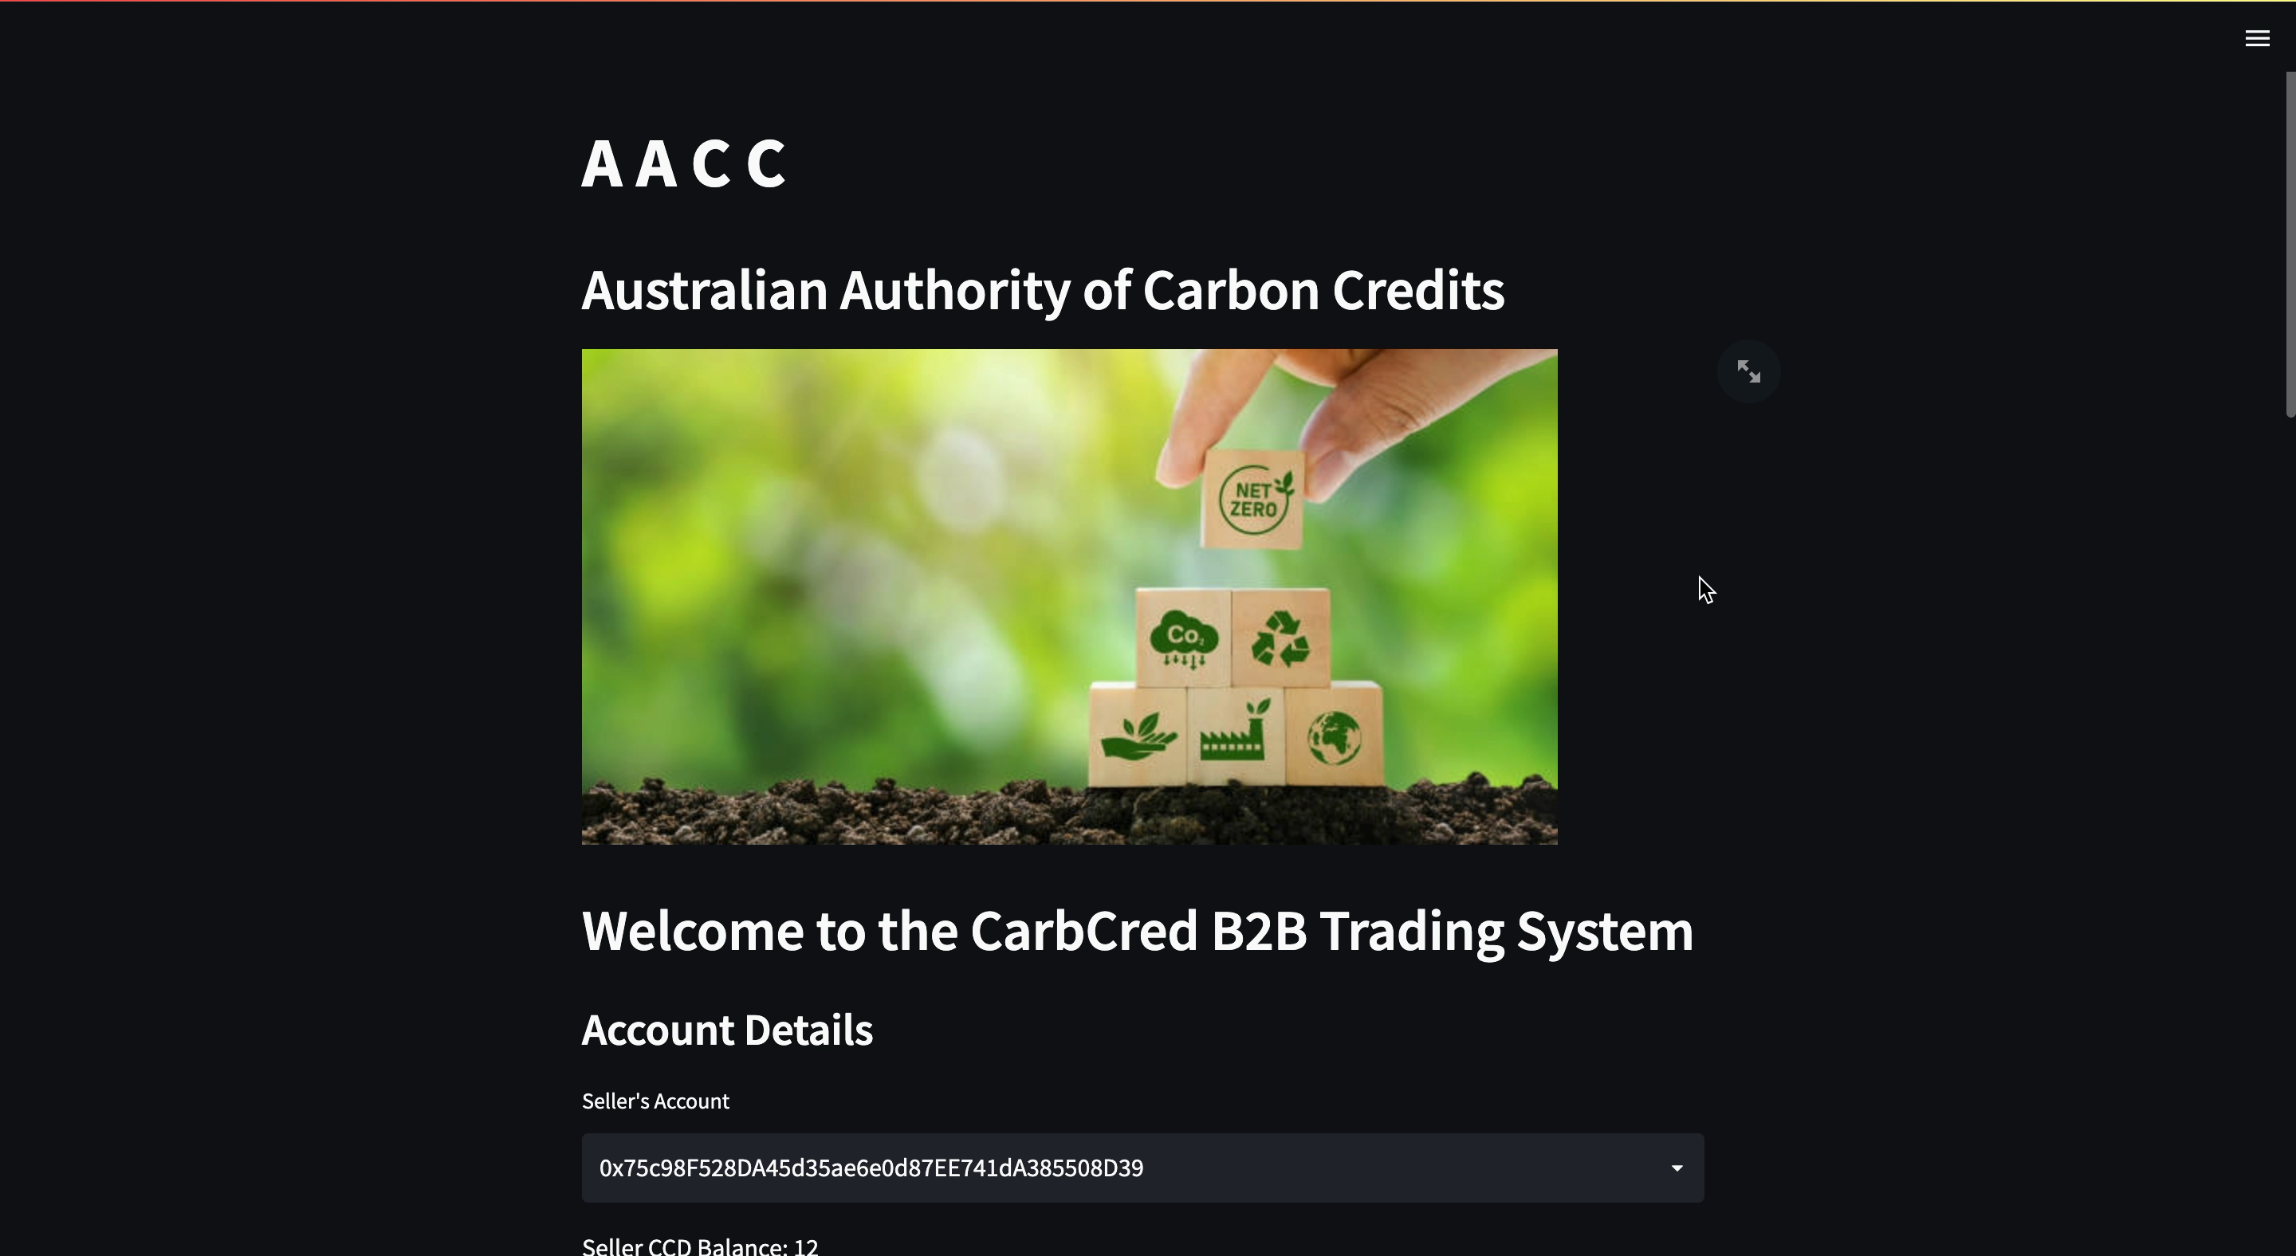

Slide 10
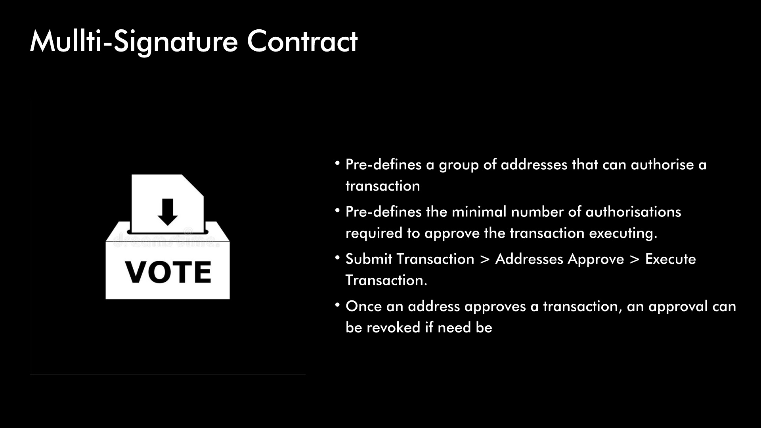

Slide 11
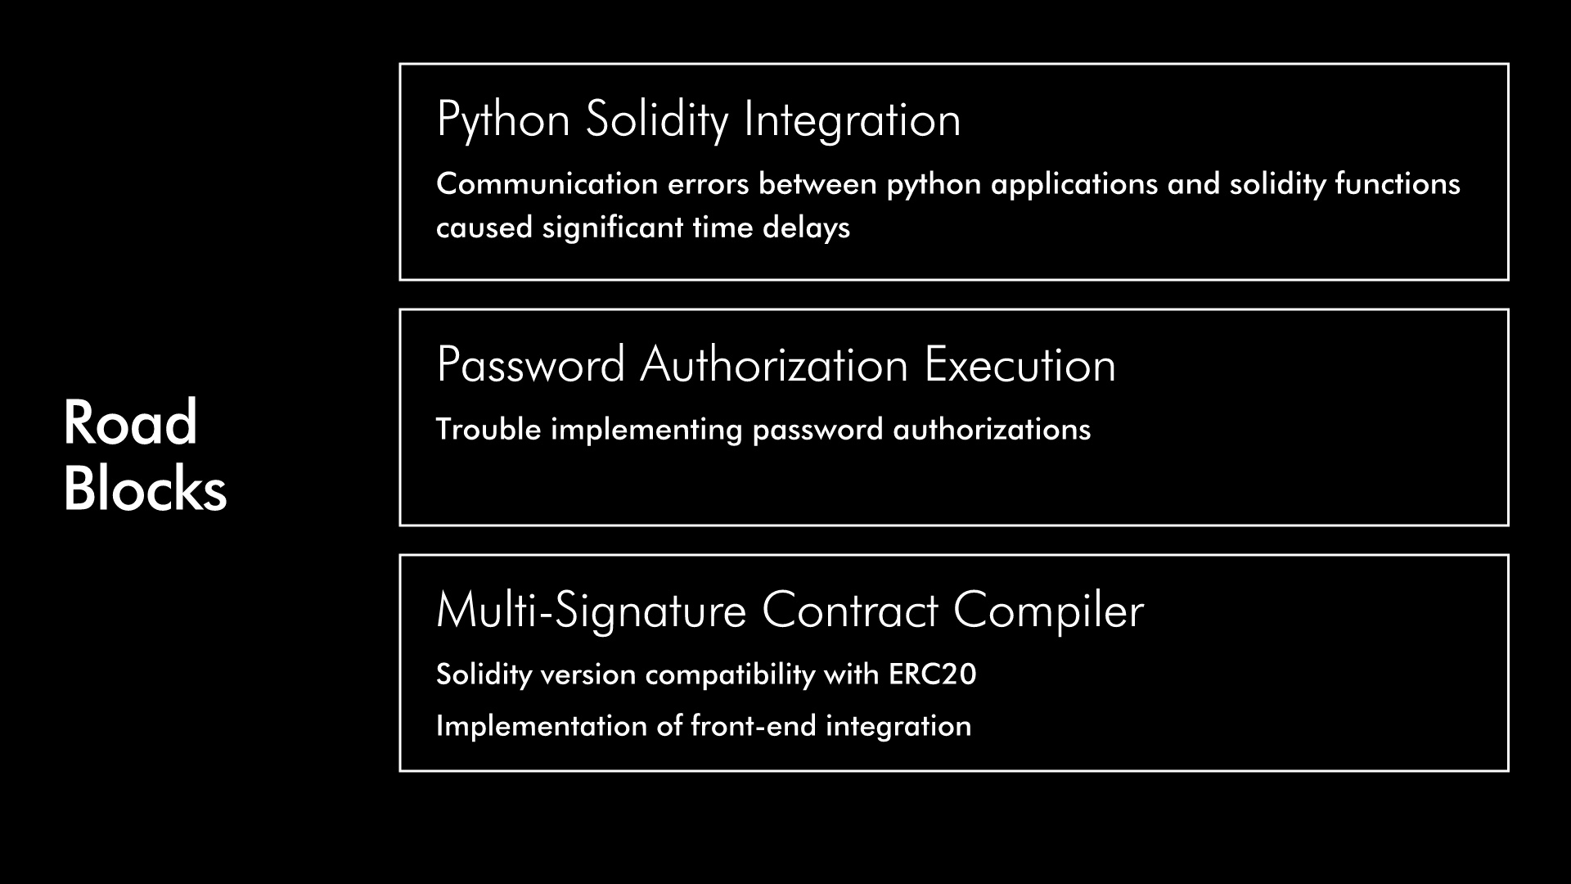

Slide 12
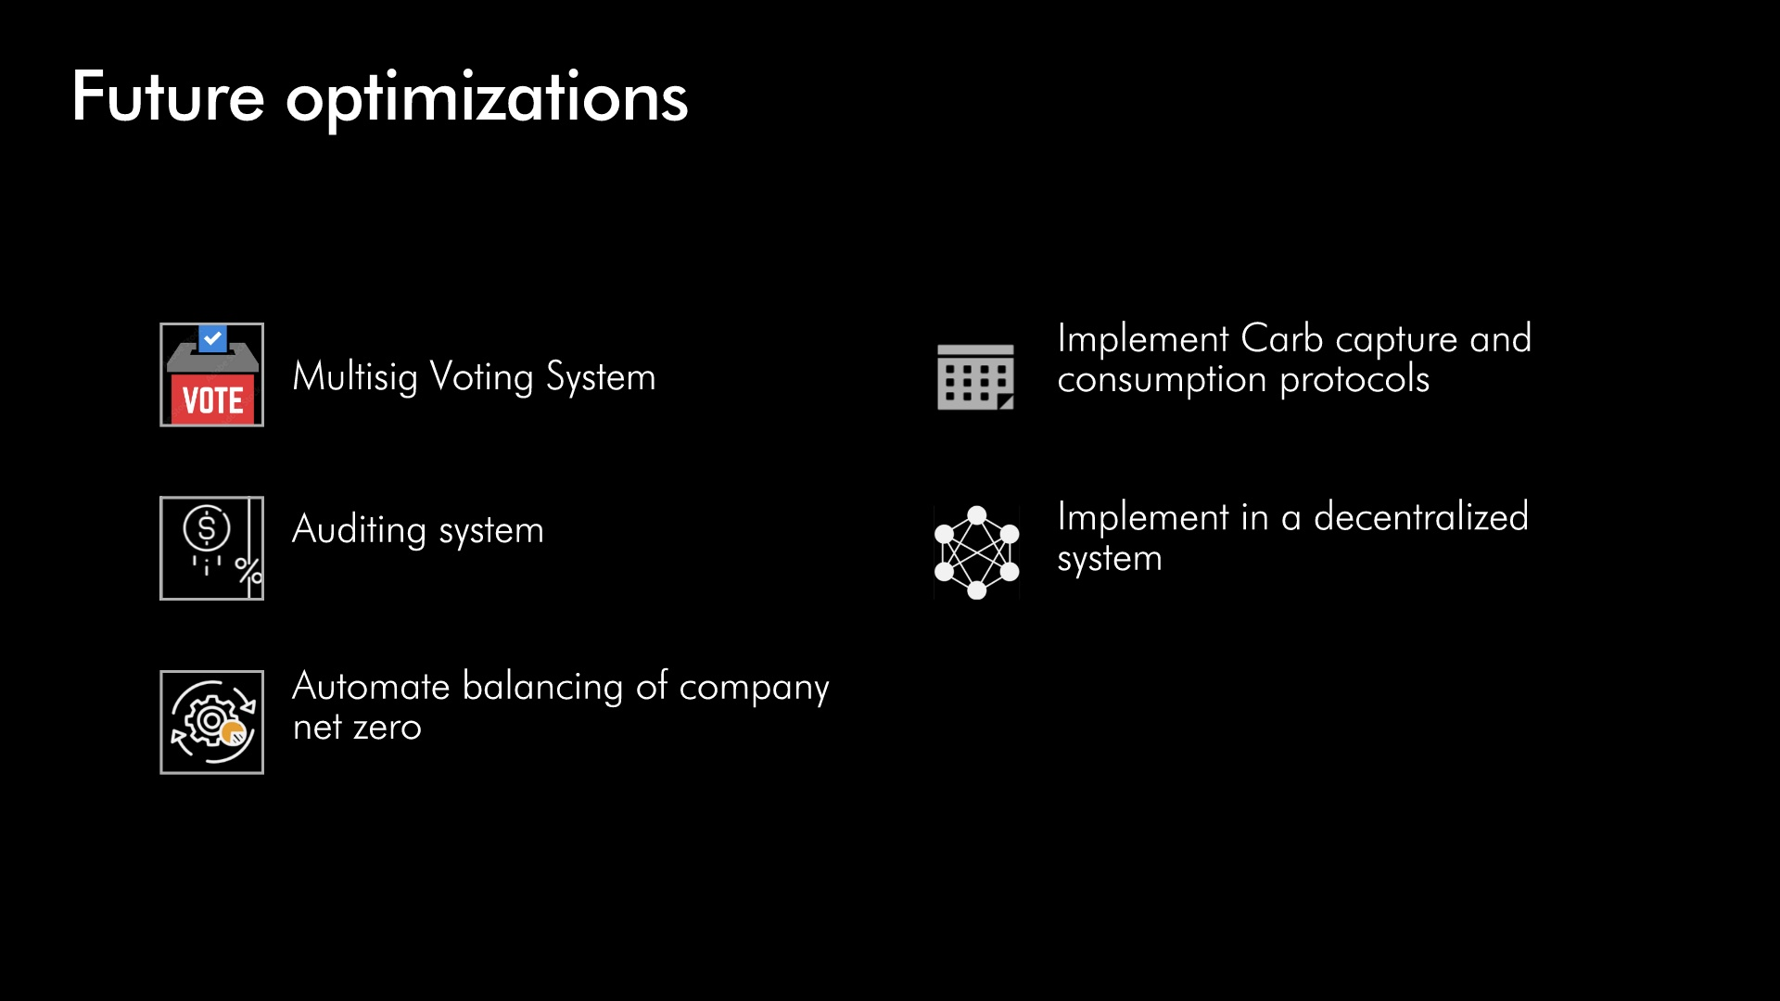

Slide 13

QUESTIONS
Github Repo : https://github.com/RPSangil/Project-3

Slide 14

Thank you

